Slide 1

cigsegy - Motivation
Options for reading and creating segy format files：
1. segysak - python
2. segyio - python
3. segymat – matlab
[data, traceheader, segyheader] = ReadSegy(segyname)

Slide 2
cigsegy - Motivation
Their features：
segysak: slow (pure python)
Segymat: slow
segyio: fast but can only deal with sorted and regular segy files
There are lots of segy format files that they are sorted but missing some traces.
For some reasons (confidentiality requirement, mistakes when recording, ...),
the file headers are broken.
We need a tool that can not only read and create segy files fast,
but also deal with these irregular data.

Slide 3
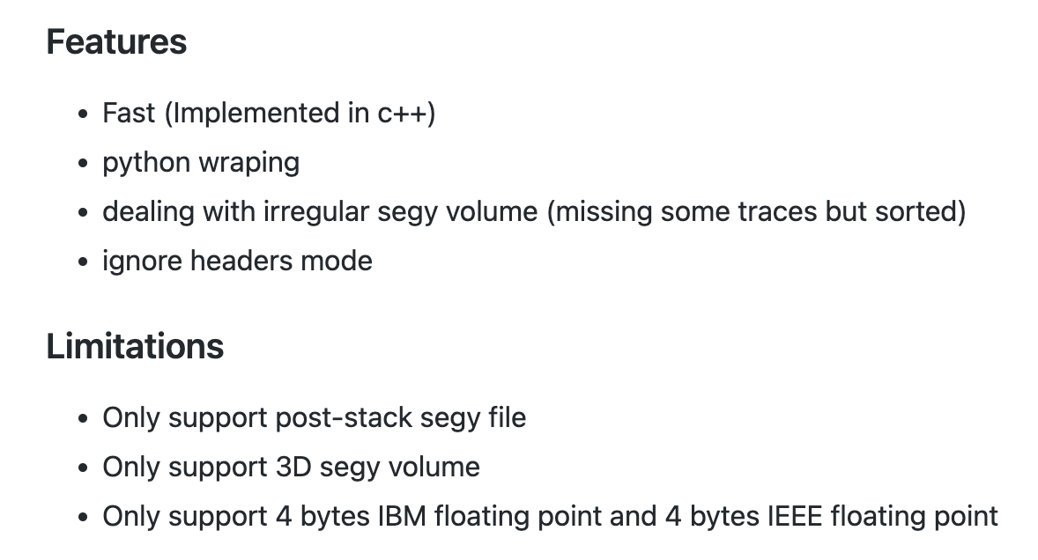
cigsegy
https://github.com/JintaoLee-Roger/cigsegy

Slide 4
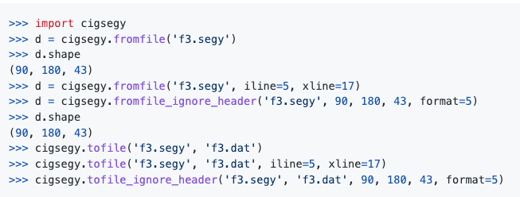
cigsegy
https://github.com/JintaoLee-Roger/cigsegy

Slide 5
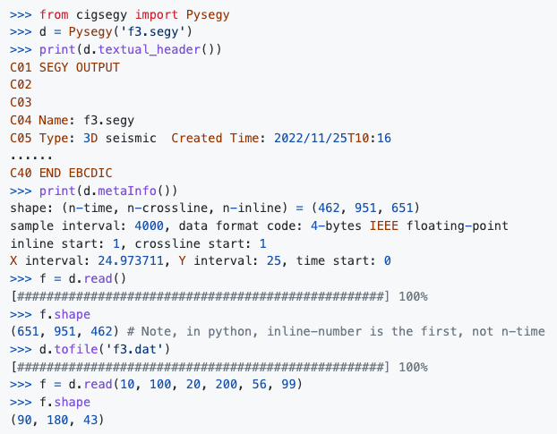
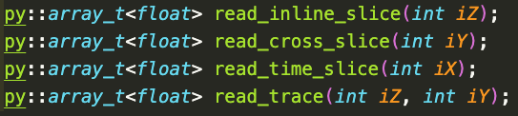
cigsegy
https://github.com/JintaoLee-Roger/cigsegy

Slide 6
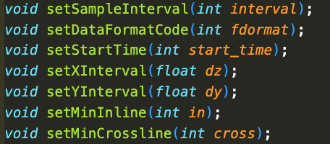
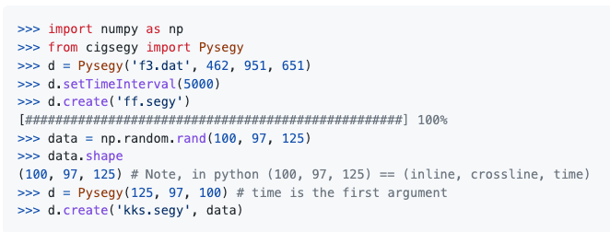
cigsegy
https://github.com/JintaoLee-Roger/cigsegy

Slide 7
cigsegy
https://github.com/JintaoLee-Roger/cigsegy
Shape = (651, 951, 462) 1.3G
Mode | cigsegy | segyio | segysak | segymat
Read | 1.212s | 0.944s | 134.8s | 151.99s
Create | 3.017s | 14.03s | - | -
Shape = (1062, 2005, 2401) 20G
Mode | cigsegy | segyio | segysak | segymat
Read | 45s x 3 | 65s+20s+19s | 612.45s | >1500s
Create | 41.14s+43.35s | 78.74s+83.76s | - | -

Slide 8
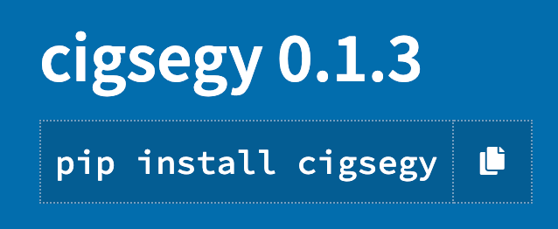
cigsegy
Install
pip install cigsegy
Linux_x86_64: python3.6-3.10
Macosx_13_0_arm64: python3.8-3.11
Windows: No machine，don’t support Now
Macosx_x86_64: No machine，don’t support Now
For details:
https://github.com/JintaoLee-Roger/cigsegy

